Slide 1

Perfume Recommender Based on Fragrant notes
CSCI – 5922: Neural Nets and Deep Learning
- Venkata Harshith Nikhil Samudrala

Slide 2
Contents
Introduction
Problem Statement
About the Data
Data Transformation
Neural Network
Results
Future Scope and Ideas

Slide 3
Introduction
The system leverages a comprehensive dataset of fragrances and user preferences to assist in the identification of suitable perfumes.
Users can specify desired perfume notes (e.g., sandal, lime, bergamot) without requiring technical knowledge of fragrance composition.
By applying advanced machine learning techniques, the system provides tailored recommendations that align with individual taste and olfactory preferences.
This approach streamlines the fragrance selection process, making it more accessible, efficient, and personalized.
The resulting recommendations offer an informed foundation for exploring and discovering novel perfumes that match user-defined criteria.

Slide 4
Problem Statement
Choosing a suitable fragrance can be overwhelming due to the vast number of options and complex scent profiles.
Many individuals lack the expertise to interpret perfume compositions, making it difficult to find scents aligned with their preferences.
The lack of a personalized and efficient recommendation system results in a trial-and-error process, which can be both time-consuming and expensive.
Existing solutions often rely on generic recommendations, failing to account for unique user preferences or specific scent characteristics.
There is a need for a robust, user-friendly tool to simplify fragrance selection by providing tailored recommendations based on user inputs and fragrance data.

Slide 5
The End
Thank You

Slide 6
About the Data
The primary dataset for this project is sourced from Fragrantica, a comprehensive online encyclopedia of perfumes that provides extensive technical details about a wide range of fragrances.
Key features of the dataset include fragrance name, notes composition, gender categorization, designer, and user reviews, which form the foundation for fragrance profiling.
A supplementary notes dataset was utilized to enrich the fragrance data by enabling detailed note profiling and enhancing descriptive attributes.
The notes dataset includes crucial features such as note name, scientific name, odor profile, and fragrance group, providing a robust basis for understanding the olfactory characteristics of each fragrance.

Slide 7
Data Transformation
The notes within the dataset were initially stored as string representations of lists. These were systematically parsed and converted into Python list objects to facilitate further processing.
Each note was enriched by mapping it to key attributes, including its scientific name, fragrance group, and odor profile, resulting in detailed descriptions for each note.
To generate input for the network, the enriched note descriptions were combined with the corresponding fragrance descriptions, producing a comprehensive enriched text representation for each fragrance.

Slide 8
Feature Engineering
Embeddings, which are numerical representations of data, are used to capture the semantic information contained within the enriched text. In this project, the SentenceTransformer model was employed to transform the enriched text into embeddings.
An embedding is a dense numerical vector that encodes the meaning of text in a format that can be processed by machine learning models.
Using the generated embeddings, the K-Means clustering algorithm was applied to group similar perfumes and identify positive and negative pairs.
A positive pair consists of two perfumes from the same cluster, whereas a negative pair comprises perfumes from different clusters. These pairs were then used as input to the Siamese network for training.

Slide 9
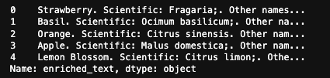
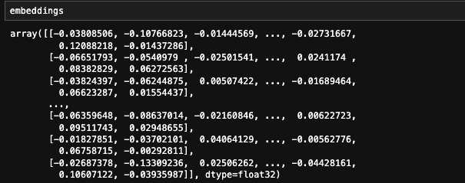

Enriched Text
Enriched Text Embeddings
Silhouette Score to determine best no.of clusters

Slide 10
Siamese Network
A Siamese network is a neural network architecture designed to determine the similarity between two inputs. It consists of two identical sub-networks that share the same weights and learn to compare the features of the inputs.
Input Layers: Accept two fragrance embeddings of shape (None, 384) as inputs, representing enriched descriptions of two perfumes.
Shared Dense Layer: Processes both inputs using 128 neurons with ReLU activation, outputting feature vectors of shape (None, 128).
L1 Distance Layer: Computes the absolute difference between the two feature vectors, resulting in a vector of shape (None, 128).
Final Dense Layer: Outputs a similarity score between 0 and 1 using a single neuron with a sigmoid activation.
Output: Produces a similarity score indicating the likelihood of the two perfumes being similar or in the same cluster.

Slide 11
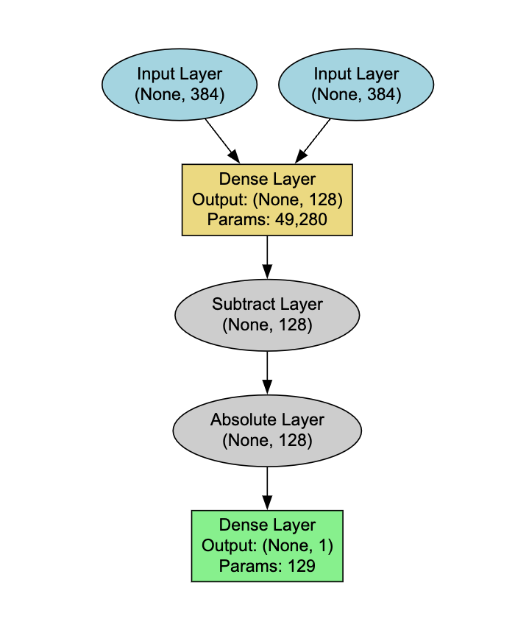
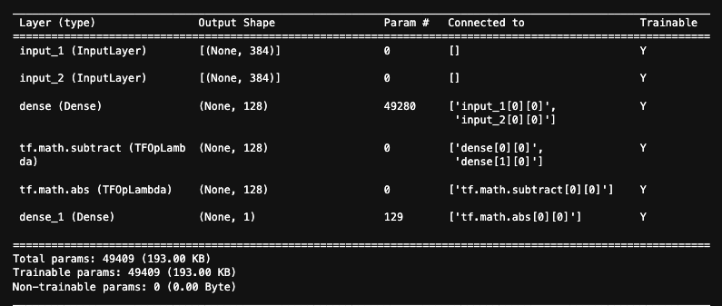
Siamese Network Architecture and Summary

Slide 12
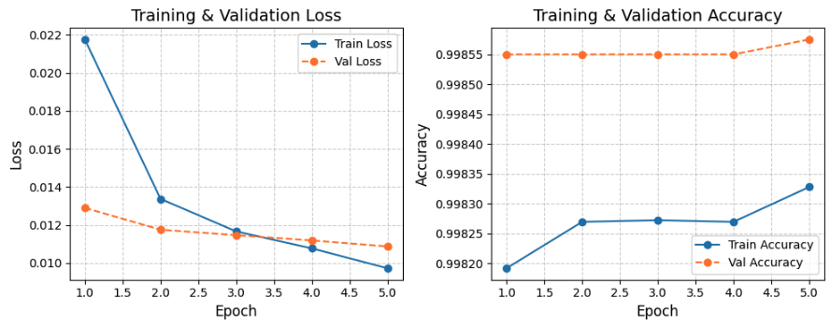
Accuracy History and Loss History

Slide 13
Accuracy History and Loss History
The training loss consistently decreases over the epochs, indicating that the model is effectively learning from the training data and minimizing the error during training.
The validation loss shows a steady decline and closely follows the training loss, suggesting that the model is not overfitting and generalizes well to unseen validation data.
The training accuracy shows a gradual increase across the epochs, demonstrating that the model’s predictive performance improves as training progresses.
The validation accuracy remains consistently high and slightly higher than the training accuracy, indicating stable model performance and robust generalization.
The minimal gap between training and validation metrics (both loss and accuracy) suggests a well-optimized model without signs of overfitting or underfitting.

Slide 14
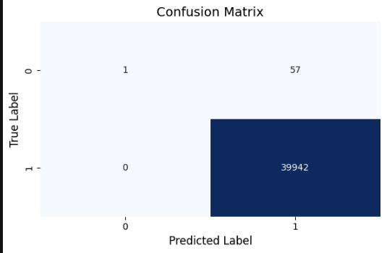
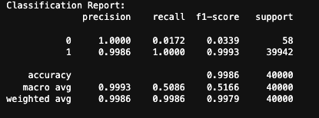
Performance Evaluation

Slide 15
Performance Evaluation
The model achieves very high overall accuracy (99.86%), with excellent precision (0.9986) and recall (1.000) for the majority class (label 1), indicating strong performance in identifying positive pairs.
The minority class (label 0) shows significant imbalance, with very low recall (0.0172), meaning most negative pairs are misclassified as positive.
The weighted average F1-score of 0.9979 reflects the dominance of the majority class in the evaluation, masking the poor performance on the minority class.
The macro-average F1-score of 0.5166 highlights the model’s inability to generalize well across both classes due to the data imbalance. Addressing class imbalance is essential to improve performance for the minority class.

Slide 16
Limitations
The dataset comprises approximately 5.9 million perfume records, which posed significant computational challenges and necessitated the use of smaller subsets for training and analysis due to resource limitations.
The reliance on subsets introduced class imbalance, particularly affecting the representation of negative pairs, which in turn impacted the model’s ability to generalize across all classes effectively.
Techniques such as stratified sampling and other advanced balancing methods, which could have mitigated the class imbalance, were not fully implemented due to computational constraints and memory limitations.
The inability to utilize the full dataset and balance the class distributions uniformly restricted the scope of the training process, potentially limiting the model’s overall performance and fairness across all data classes.

Slide 17
Checking the Performance of Recommender
The enrich_single_note function standardizes and enriches each note using the note_enrichment dictionary or returns the original note if no enrichment is available.
The recommend_fragrances_by_notes function creates a query embedding from user-provided notes and compares it with fragrance embeddings.
An optional gender filter restricts the recommendations to fragrances matching the specified gender (e.g., Men, Women, Unisex).
Feed the query embedding and perfume embeddings into the Siamese network to compute similarity scores.
This would utilize the Siamese network’s learned ability to better distinguish subtle relationships between perfumes
The top k most similar fragrances are identified based on similarity scores and returned as recommendations.
User inputs for notes and gender are collected, processed, and passed to the recommendation function, which outputs personalized fragrance suggestions.

Slide 18
Checking the Performance of Recommender

Slide 19
Conclusion
Developed a Siamese network-based fragrance recommendation system using enriched text embeddings and cosine similarity.
Achieved high accuracy (99.86%) with strong performance in identifying positive pairs.
Faced limitations due to resource constraints, leading to class imbalance and reduced performance on minority classes.
Full dataset utilization and advanced balancing methods were restricted by computational limitations.
Future improvements include leveraging better resources, addressing class imbalance, and utilizing more data for improved fairness and generalization.

Slide 20
Future Scope
Include olfactory data like intensity, longevity, and seasonal preferences for more detailed recommendations.
Incorporate user reviews and ratings for personalized, sentiment-driven recommendations.
Expand the dataset to cover a wider range of perfumes and user demographics.
Use advanced techniques like transfer learning to recommend fragrances based on multiple criteria.
Develop a hybrid system combining content-based and collaborative filtering for richer recommendations.

